Slide 1
Improving Big Mountain Resort pricing strategy
Igor verevkin
September 2020

Slide 2
Problem identification
Big Mountain Resort, a Montana based ski resort with 350,000 visitors each year, obtained a good quality infrastructure that was modernized recently. However, the management sets tickets price just based on the market average and doesn’t take into account resort’s infrastructure.
How can Big Mountain resort improve pricing strategy and increase revenue by fully capitalizing on its facilities?

Slide 3
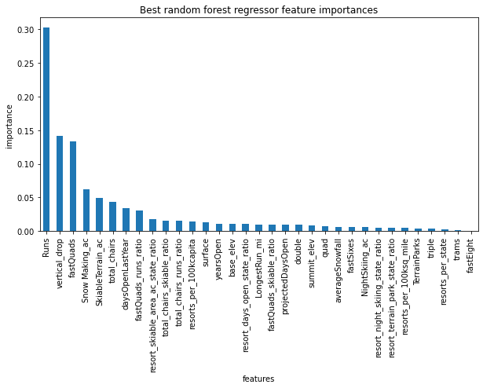
Recommendations and key findings
The model showed that the most important parameters for ticket price are number of runs, vertical drop, number of fast quads, snow making in acres, skiable terrain in acres and total number of chairs.
In order to increase revenue the management team should fully capitalize on these features and set a fair ticket price with regard to the market average.

Slide 4
Model selection
We used two models here – linear regressor and random forest regressor.
After assessing models performances we pick random forest regressor as our main model because it shows better results in terms of prediction accuracy.

Slide 5
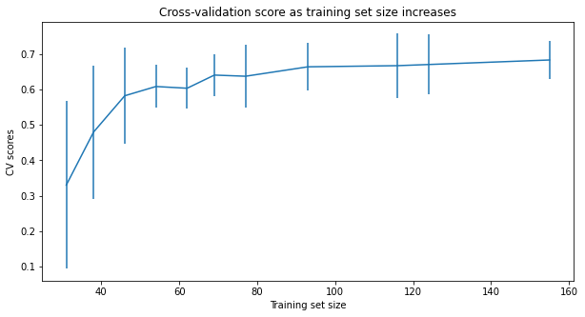
Dataset size concerns
The dataset ‘ski_resort_data.csv’ provided by the company consists of only 300 observations.
Is it enough to build a model and make an accurate prediction?
The cross-validation score shows that we have plenty of data. There's an initial rapid improvement in model scores, but it's essentially levelled off by around a sample size of 40-50

Slide 6
Data insufficiency concerns
The dataset provided lacked some important information so it is advisable for a management team to match the modeling results to their domain knowledge in order to make a balanced decision regarding the company’s pricing strategy

Slide 7
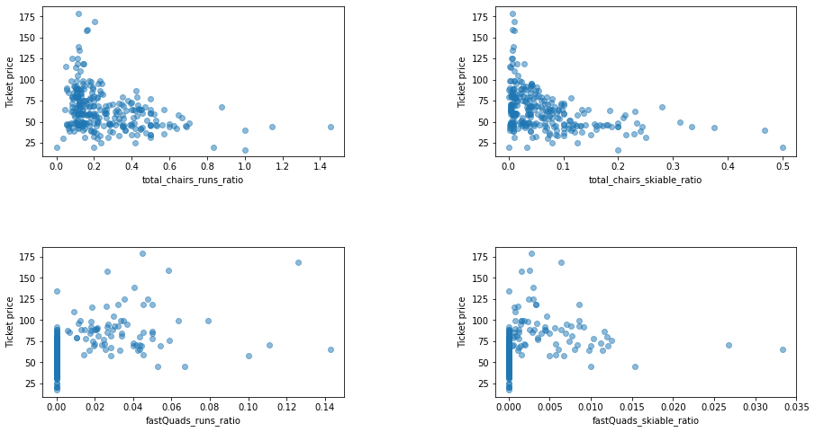
Transportation features and ticket price
The model shows negative correlation between resort’s transport infrastructure and ticket price
It seems counterintuitive, but might be explained by an exclusive vs. mass market effect - resorts with fewer chairs will have less people so they charge more for a ticket

Slide 8
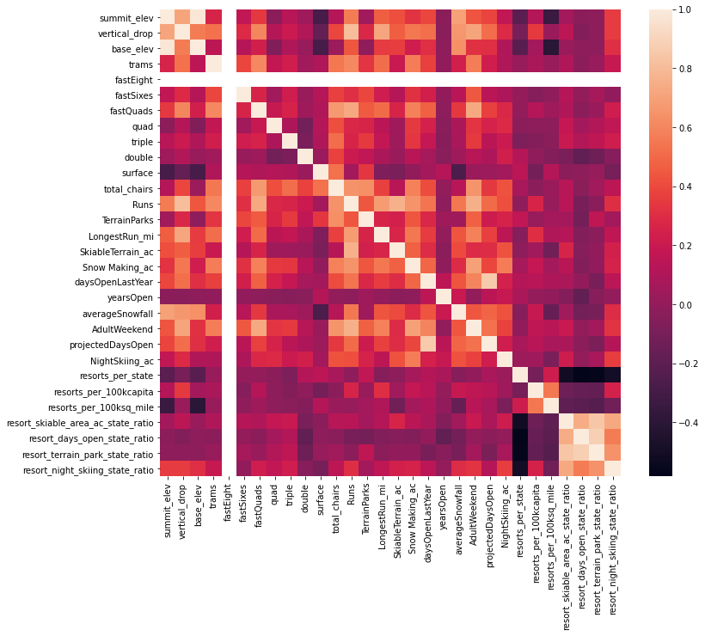
Price vs. other features correlation
The heatmap shows the degree of correlation between different features
We can see that ticket price is highly correlated with number of runs, vertical drop, fast quads, total number of chairs, skiable terrain and snow making in acres

Slide 9
Conclusion
We built a simple Random Forest model for finding the importance of different resort’s features. It allowed us to understand which of them the management should pay close attention to in order to increase company’s revenue and improve pricing strategy
The model accurately predicted the most important features, however, we should take into account that the dataset lacked some important data and it might affect the real-life value of predictions made by the model.

